Slide 1
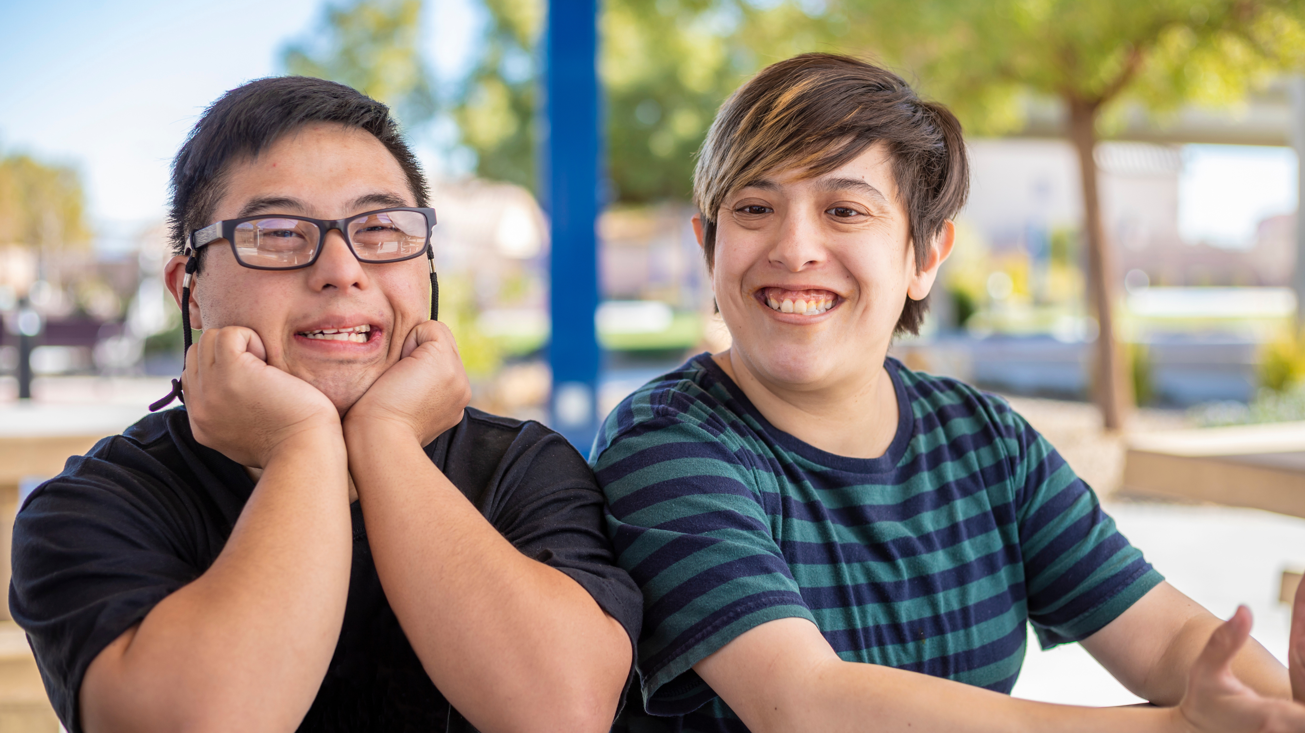

Thank You! By supporting Lutheran Social Services, you make a difference in the lives of 30,000 people every year.

Slide 2

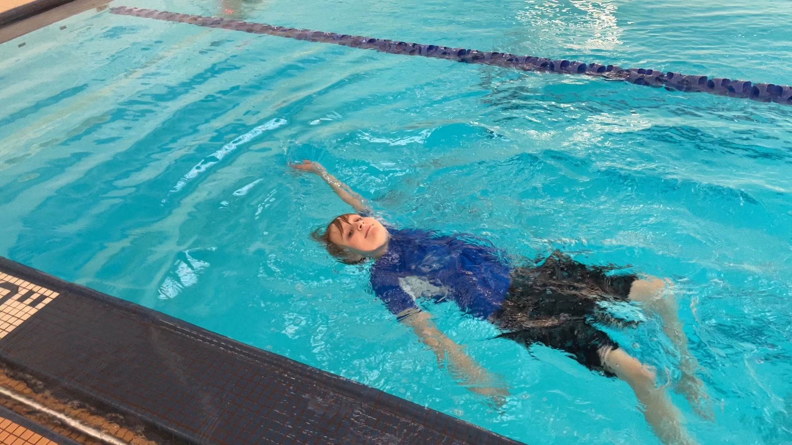

“We want to say thank you for everything you have done to help our family.”
Ben passed his swimming test!

Slide 3


www.lsswis.org

