Slide 1


www.lsswis.org

Slide 2

Thank You!
By supporting Lutheran Social Services, you make a difference in the lives of 30,000 people every year.

Slide 3
www.lsswis.org

Slide 4

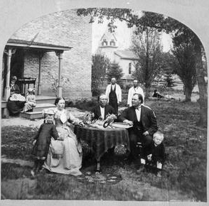
From humble beginnings in 1882, LSS has grown into a vital social services agency supporting individuals and families across every stage of life.

Slide 5
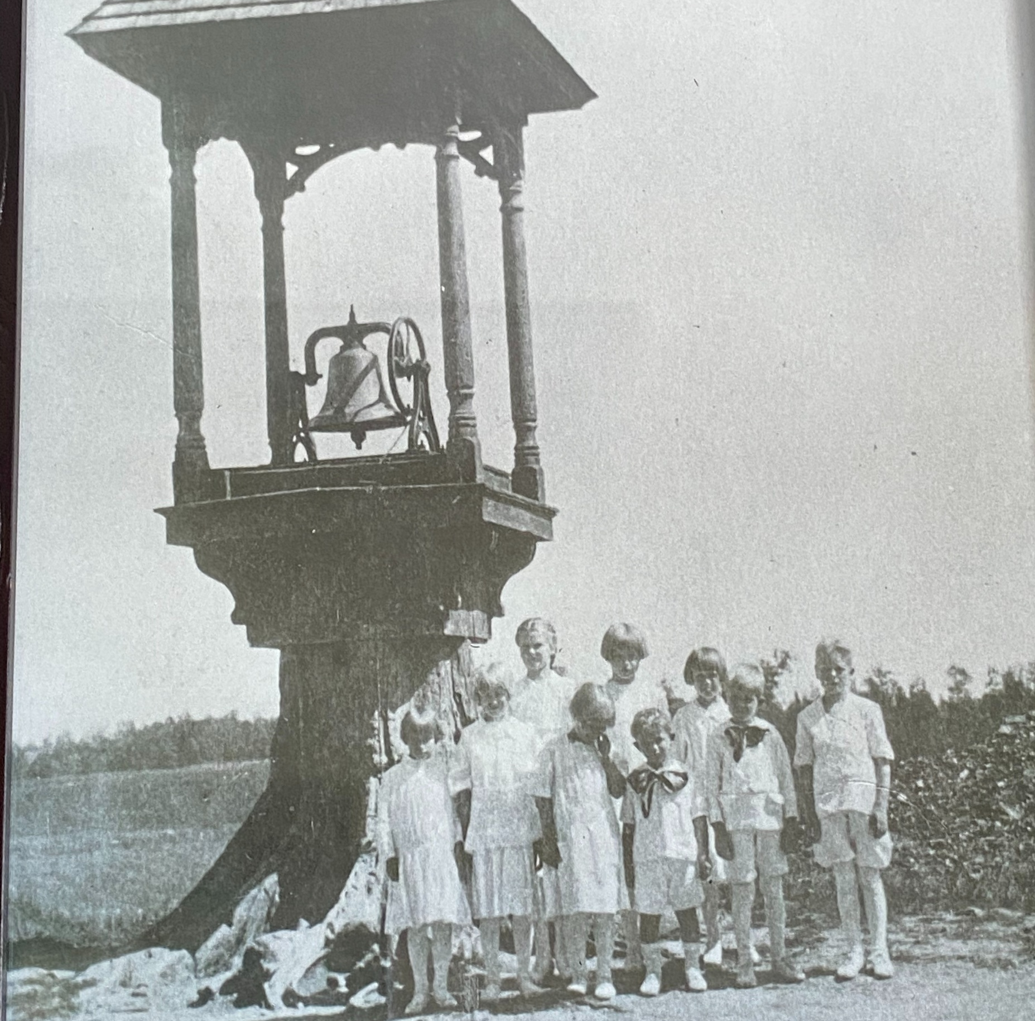
From humble beginnings in 1882, LSS has grown into a vital social services agency supporting individuals and families across every stage of life.

Slide 6
www.lsswis.org

