Slide 1


www.lsswis.org

Slide 2

Thank You!
By supporting Lutheran Social Services, you make a difference in the lives of 30,000 people every year.

Slide 3
www.lsswis.org

Slide 4

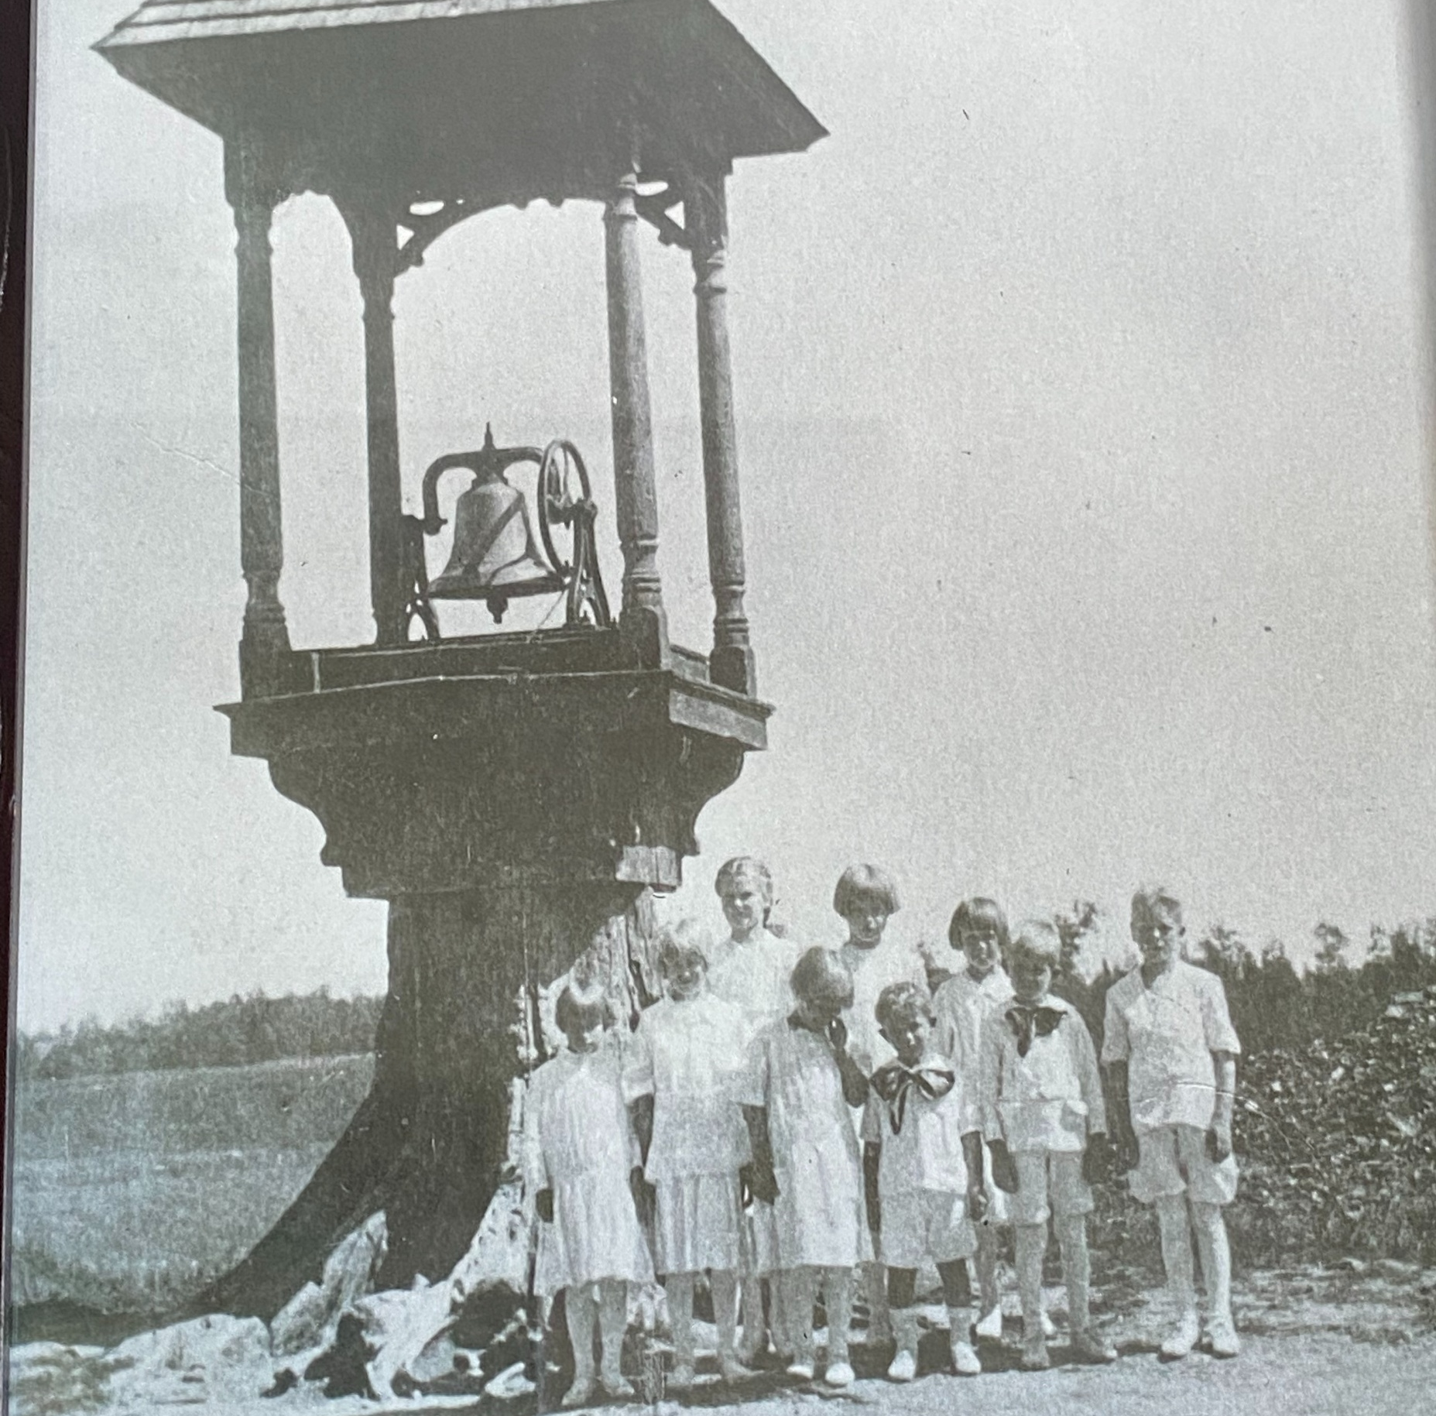
Lutheran Social Services of Wisconsin and Upper Michigan got its start in1882 in Wittenberg, WI as an orphanage founded by a Lutheran pastor.

Slide 5
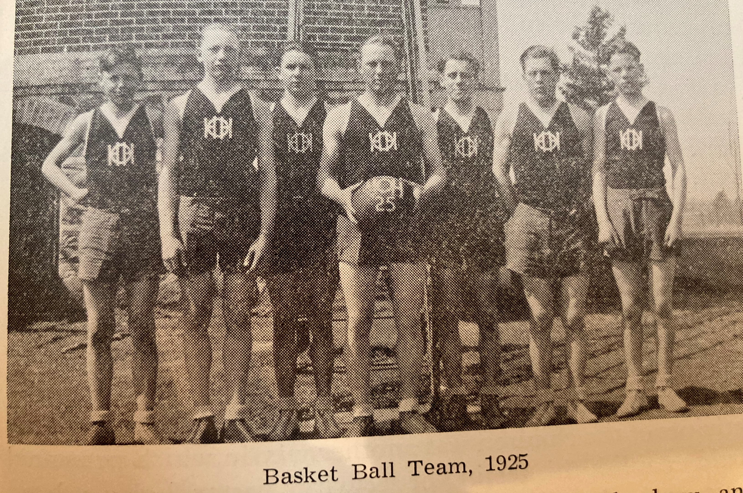
Lutheran Social Services of Wisconsin and Upper Michigan got its start in1882 in Wittenberg, WI as an orphanage founded by a Lutheran pastor.

Slide 6
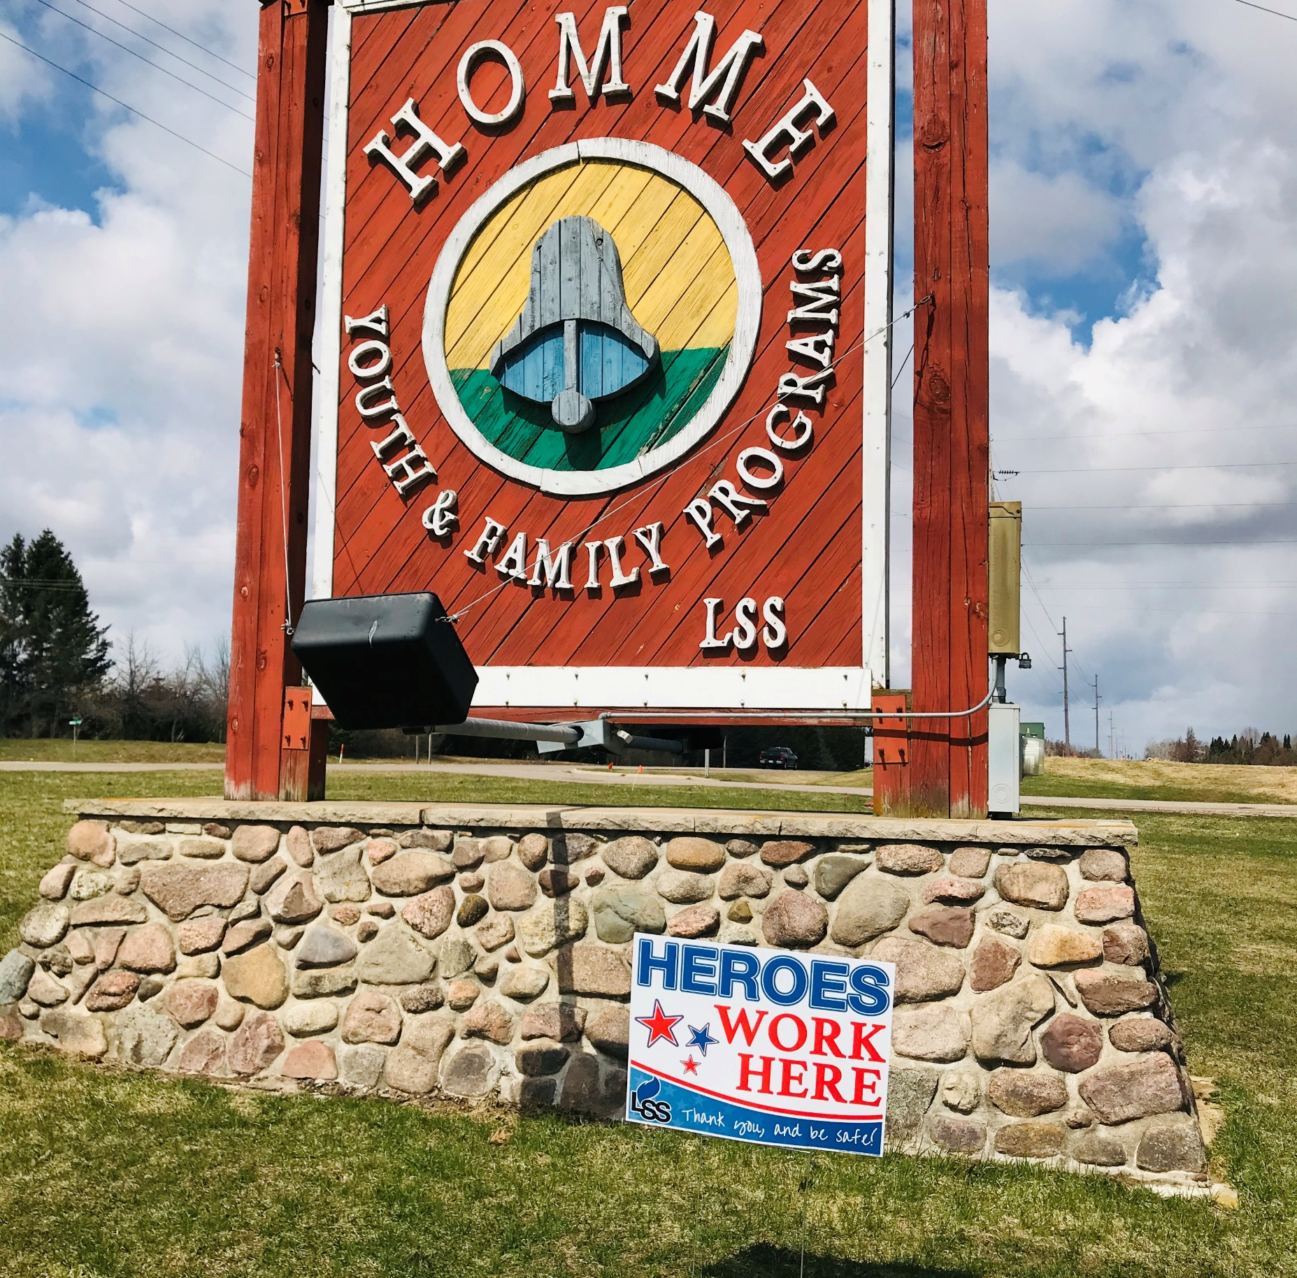
More than 140 years later, LSS continues to care for children in need at this site and across our two-state reach.

Slide 7
www.lsswis.org

